Slide 1

Out Here in the Fields
Lessons Learned from a Different Database
The Great ILS-Data Pre-Conference
Daniel Messer
Polaris ILS Administrator
Library Systems & Services

Slide 2

Hello, I’m Dan
I like bright text on dark backgrounds

Slide 3
Hello, I’m Dan
I like bright text on dark backgrounds
30 years in libraries
Polaris ILS admin for Library Systems & Services
SQL Hacker

Slide 4

https://cyberpunklibrarian.com/iug2026

Slide 5

MARC Sucks, I Know
MARC… ewwww
It was fine… for the late 60s
MARC is 60 years old
Old != Broken
Obfuscated, obtuse, generally weird

Slide 6
Disclaimer
I am one of those weirdos who believes that all aspects of the discovery tools, processes, and categorizations should be open and understandable to the reader.

Slide 7
And while we’re at it…
I also have feelings about the Dewey Decimal System…

Slide 8
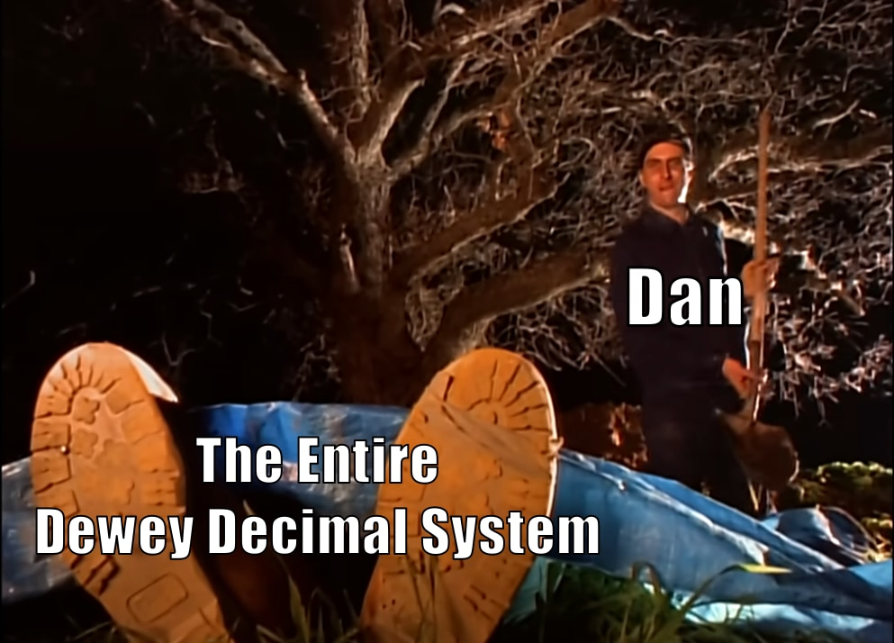

Slide 9
Hold on… let the old man reminisce
Bill Schickling and his team really did something profound
They “database-ized” MARC
In Polaris, a MARC record is stored in multiple tables and pulled together through SQL.
You can pull a basic MARC record with less than 30 lines of SQL

Slide 10
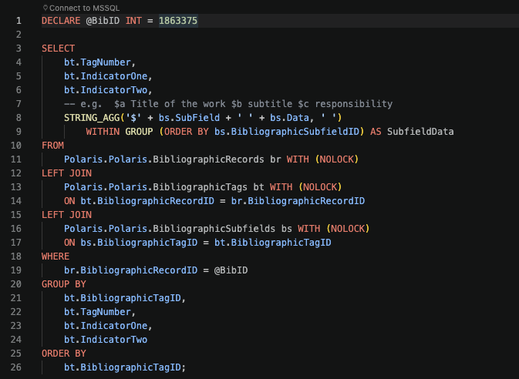

Slide 11
But wait! MARC still sucks…
And don’t even get me started on BIBFRAME
SURELY THERE ARE BETTER WAYS TO CATALOGUE?!

Slide 12


Slide 13
A Better Way®
A database that handles bibliographic data
Instead of numbered tags, we’re going to use descriptive identifiers
In other words… words
020 sub a = ISBN
We’ll just call it an ISBN
024 = Title
We can just call it “Title”

Slide 14
Pragmatic Cataloguing

Slide 15
Everything’s relational
Using a relational database
In use for 19 years
The system is wide open
And customizable
Because the entire system is free and open source

Slide 16


Slide 17
Calibre
FOSS eBook management system
Created by Kovid Goyal
A standard for eBook management

Slide 18
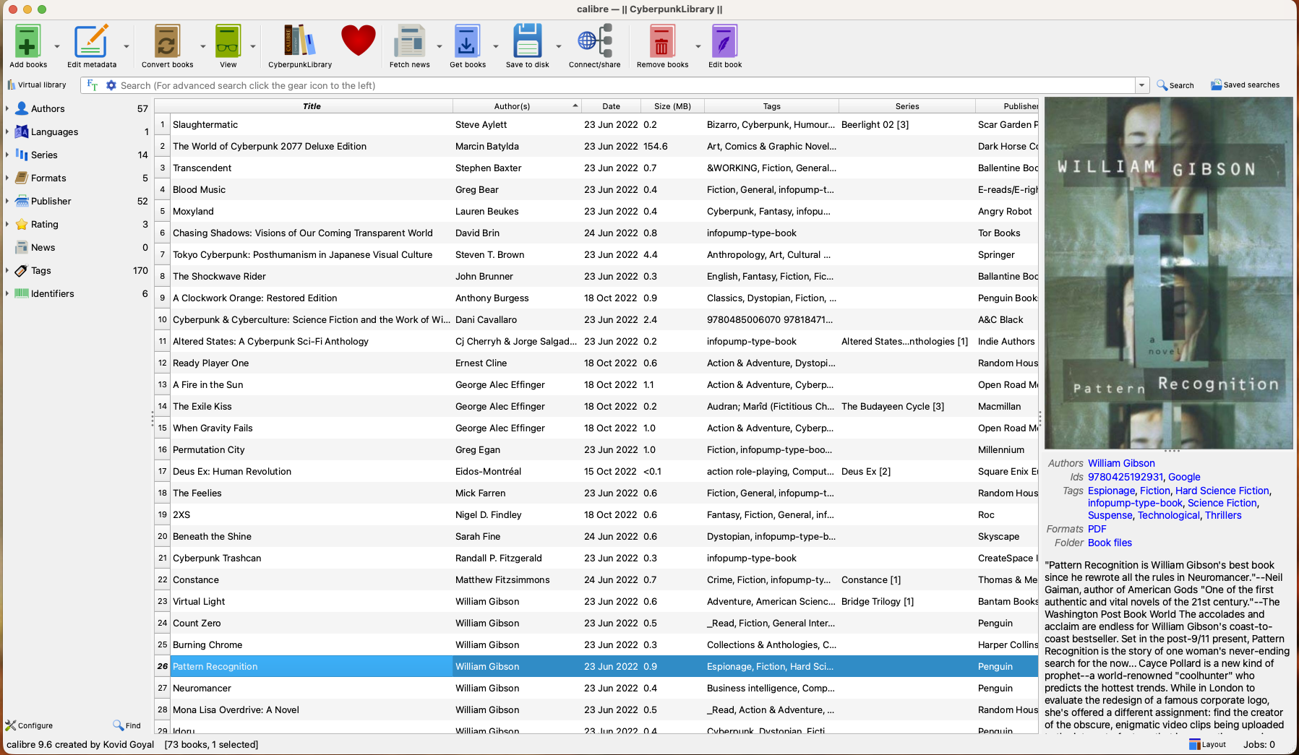

Slide 19
SQLite
SQLite is everywhere
Almost any app on your phone is using SQLite
Syntax differences aren’t too bad

Slide 20
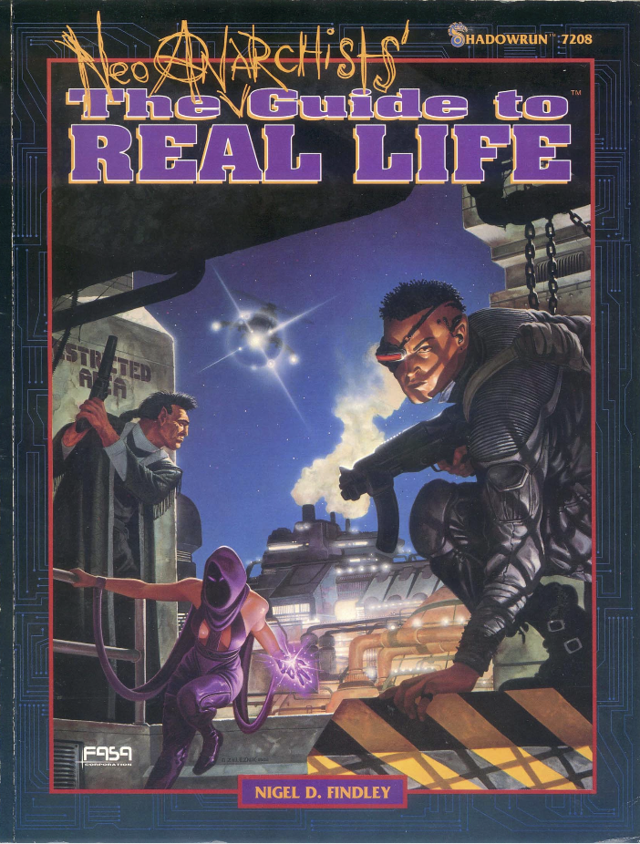

Slide 21
Title: Neo-Anarchists’ Guide to Real Life
Author: Findley, Nigel D.
ISBN: 9781555601652
OCLC: 29962928
Publisher: FASA Corporation
Pub Year: 1992
Series: Shadowrun; 7208

Slide 22
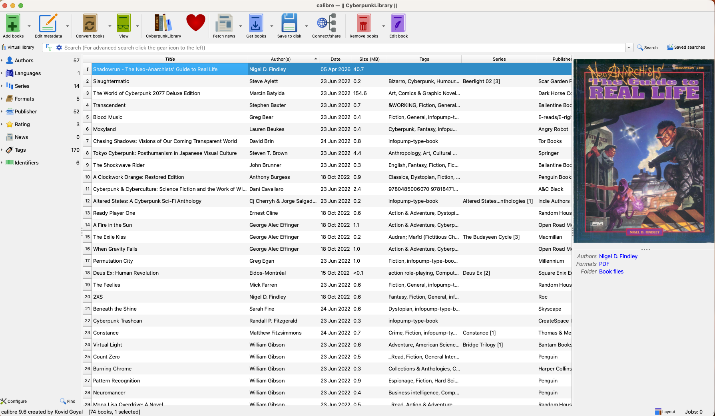

Slide 23
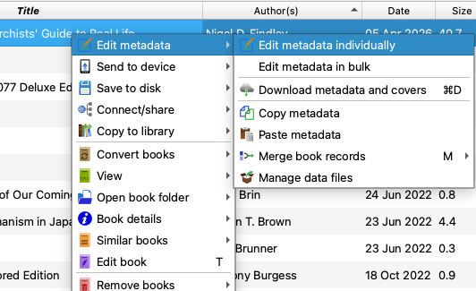

Slide 24
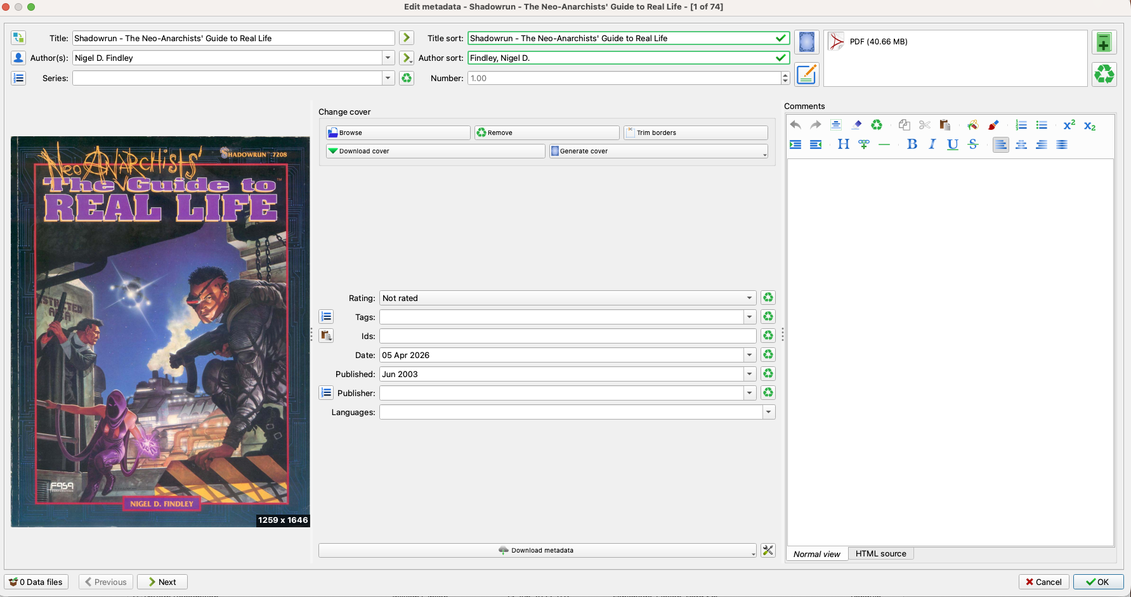

Slide 25
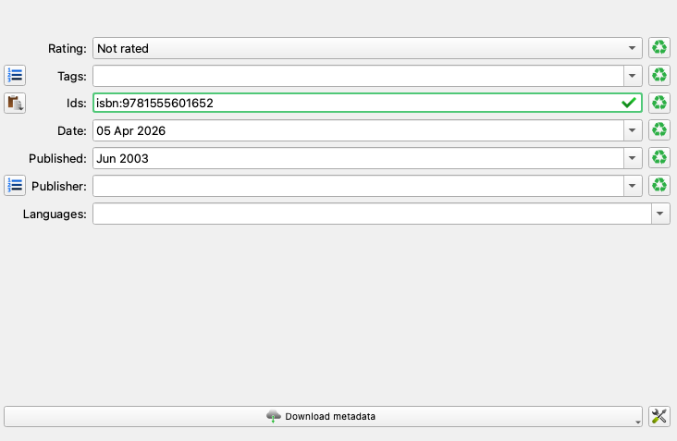

Slide 26
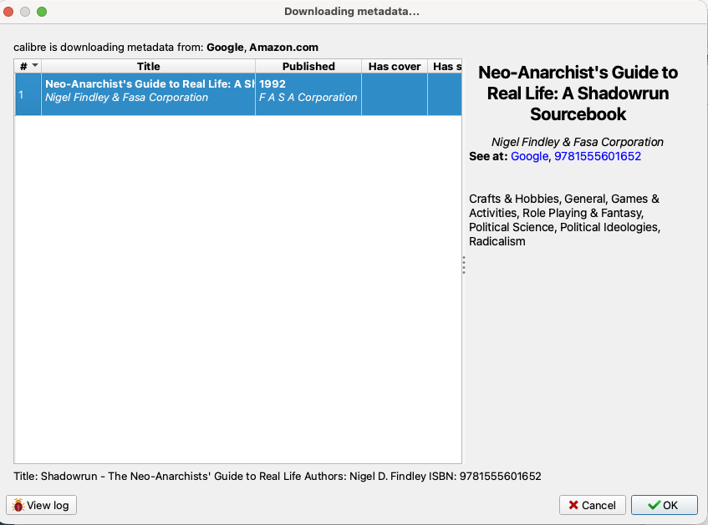

Slide 27
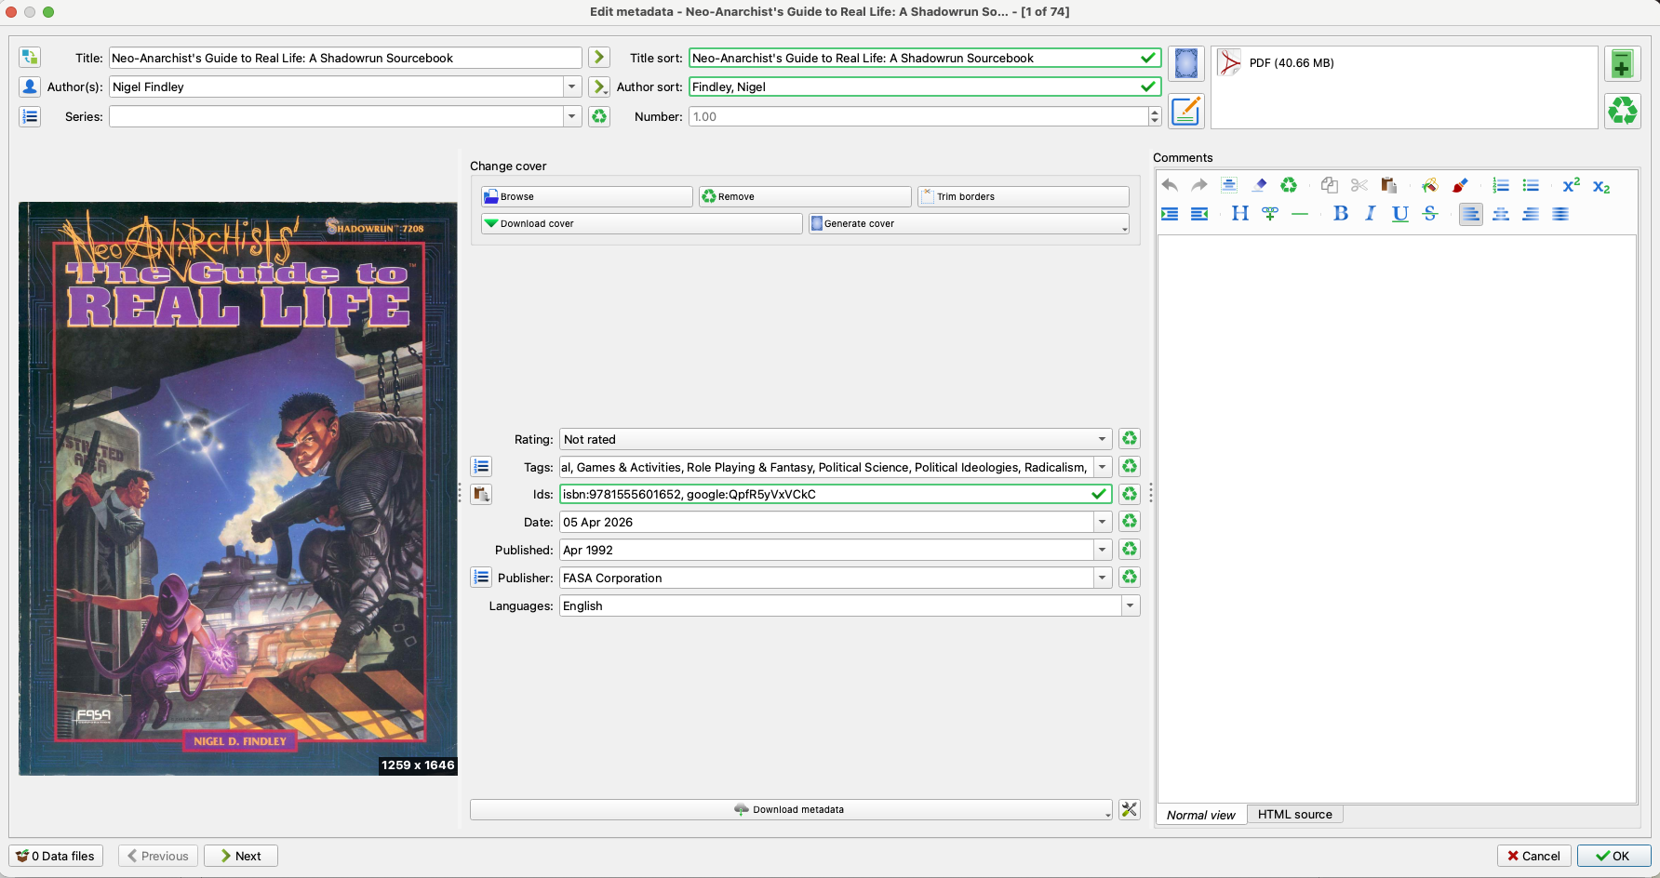

Slide 28
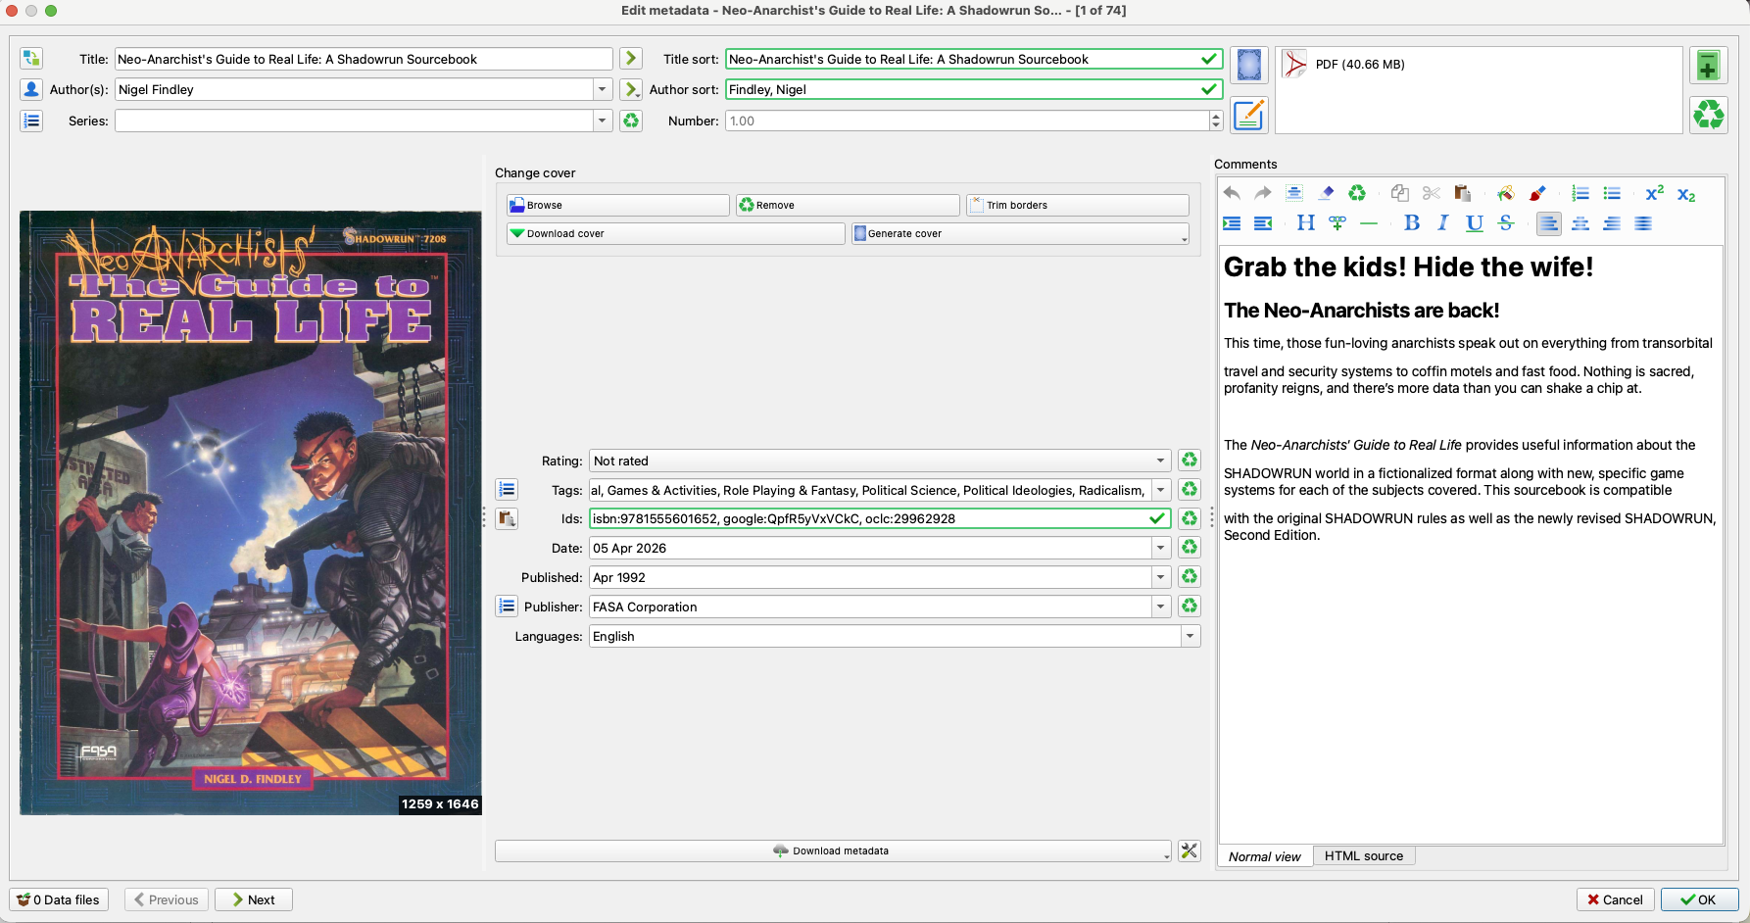

Slide 29
Thank you!

